Slide 1
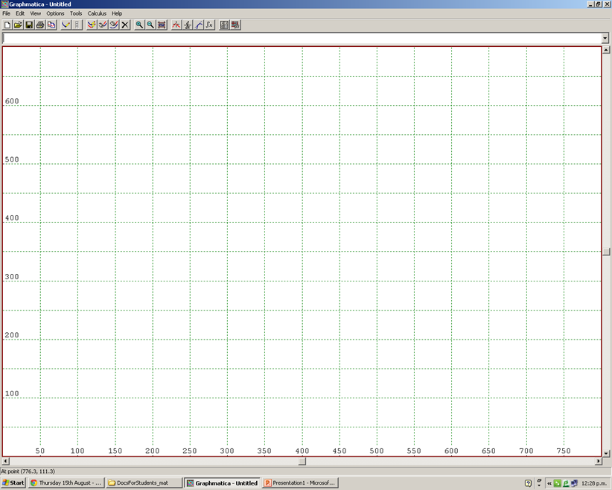
Graphs for gardening problem
f
t

Slide 2
Graphs for gardening problem
f
0.4t + 0.2f ≤ 120 (hours)
0.1t + 0.1f ≤ 40 (soil)
0.2t + 0.4f ≤ 140 (space)
t

Slide 3
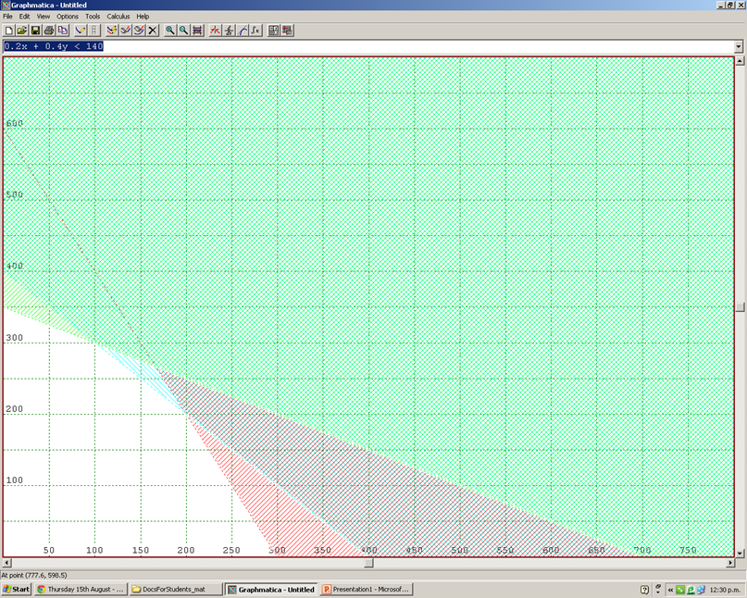
Graphs for gardening problem
f
0.4t + 0.2f ≤ 120 (hours)
0.1t + 0.1f ≤ 40 (soil)
0.2t + 0.4f ≤ 140 (space)
Now optimise the score function
S=10t + 8f
t | f | S=10t + 8f
0 | 350 | 2800
100 | 300 | 3400
200 | 200 | 3600
300 | 0 | 3000
t
She should plant 200 trees and 200 flowerbeds to get a maximum score of 3600

Slide 4
Graphs for gardening problem
f
0.4t + 0.2f ≤ 120 (hours)
0.1t + 0.1f ≤ 40 (soil)
0.2t + 0.4f ≤ 140 (space)
Now optimise the score function
S=10t + 8f
Let’s make some changes (for excellence) and see what happens...
t

Slide 5
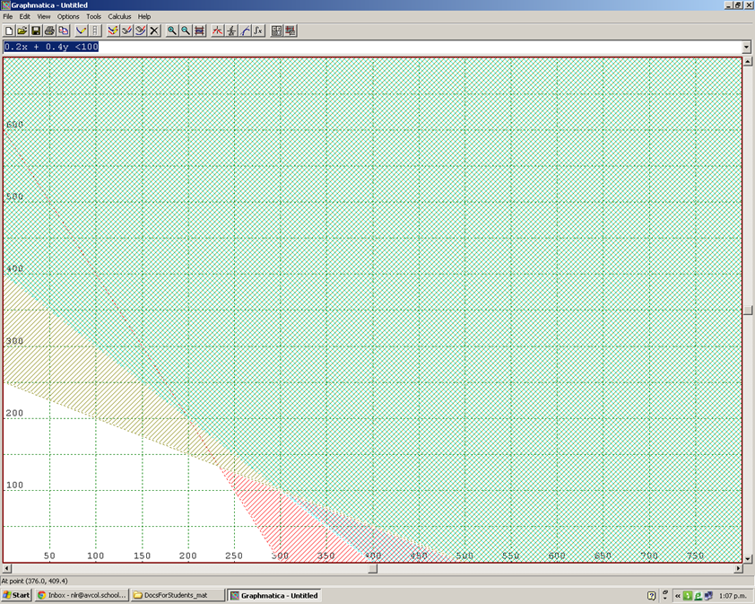
Graphs for first change
f
0.4t + 0.2f ≤ 120 (hours)
0.1t + 0.1f ≤ 40 (soil)
0.2t + 0.4f ≤ 100 (space)
Now optimise the score function
S=10t + 8f
t | f | S=10t + 8f
0 | 250 | 2000
300 | 0 | 3000
233 | 133 | 3394
t
Will now plant more trees and less flowerbeds, but overall score is lower

Slide 6
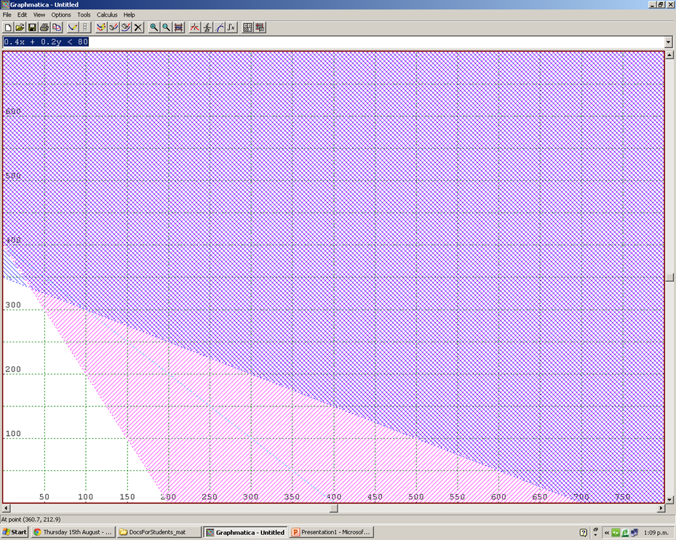
Graphs for second change
f
0.4t + 0.2f ≤ 80 (hours)
0.1t + 0.1f ≤ 40 (soil)
0.2t + 0.4f ≤ 140 (space)
Now optimise the score function
S=10t + 8f
t | f | S=10t + 8f
0 | 350 | 2800
200 | 0 | 2000
33 | 333 | 2994
t
Will now plant less trees and more flowerbeds, but overall score is lower

Slide 7
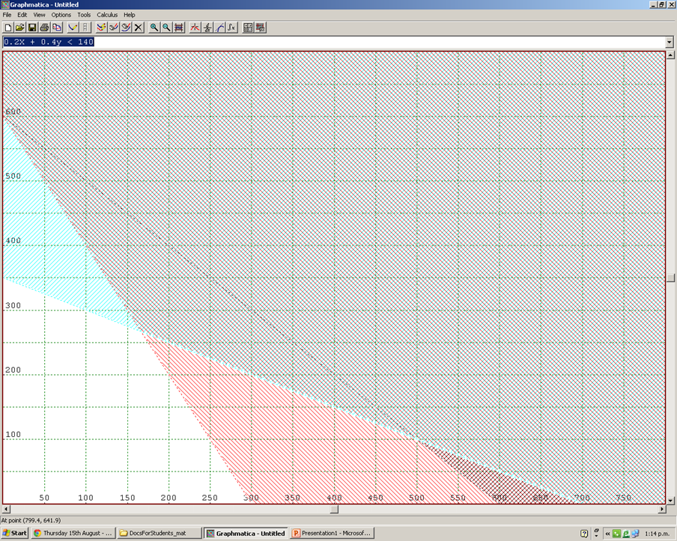
Graphs for third change
f
0.4t + 0.2f ≤ 120 (hours)
0.1t + 0.1f ≤ 60 (soil)
0.2t + 0.4f ≤ 140 (space)
Now optimise the score function
S=10t + 8f
t | f | S=10t + 8f
0 | 350 | 2800
300 | 0 | 3000
166 | 266 | 3788
t
Will now plant less trees and more flowerbeds, but overall score is higher!

Slide 8
Graphs for fourth change
f
0.4t + 0.2f ≤ 120 (hours)
0.1t + 0.1f ≤ 40 (soil)
0.2t + 0.4f ≤ 140 (space)
Now optimise the score function
S=12t + 8f
t | f | S=12t + 8f
0 | 350 | 2800
100 | 300 | 3600
200 | 200 | 4000
300 | 0 | 3600
t
Will now plant the same number of trees and flowerbeds, but the overall score is higher!

